Slide 2
ODOT/OCA Traffic Safety Partnership

Slide 3
ODOT/OCA Traffic Safety Partnership
Goal – A partnership to improve worker and vehicle safety inside and around our work zones.
Scope – Anything that can improve safety (standards, new products, policies, communication, education, enforcement, etc.).

Slide 4
ODOT/OCA Traffic Safety Partnership
Purpose of this presentation:
Raise awareness of the partnership
Frame the problem with data
Seek input from you

Slide 5
ODOT/OCA Traffic Safety Partnership
Can you “Engineer” for this???

Slide 6
ODOT/OCA Traffic Safety Partnership
The Data
* workzonesafety.org

Slide 7
ODOT/OCA Traffic Safety Partnership
Work Zones Are Dangerous Places
In 2014 there were 669 fatalities in U.S. work zones.*
That’s equivalent to every passenger dying on a full Greyhound bus every month.
In Ohio Work Zones (2003 – 2012):
56,945 vehicle crashes occurred in Ohio work zones in that same 10-year period.
20,590 vehicle crashes occurred in Ohio work zones when workers were present.
19,988 of the total vehicle crashes were rear end collisions.
The top three causes of work zone crashes are:
Following too closely
Failure to control
Improper lane changes
* workzonesafety.org

Slide 8
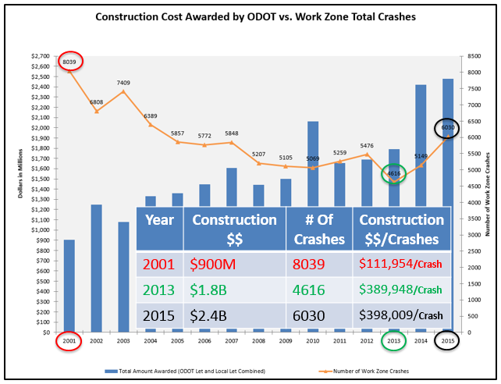
ODOT/OCA Traffic Safety Partnership

Slide 9
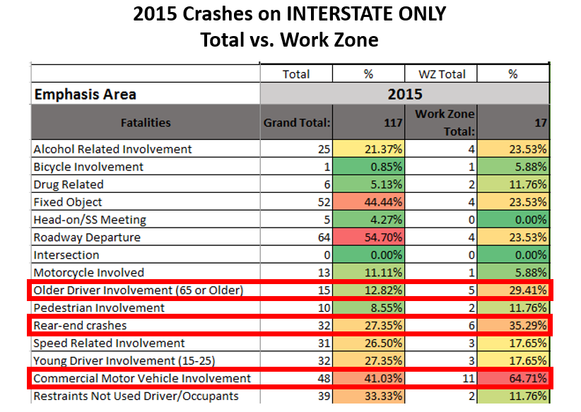
ODOT/OCA Traffic Safety Partnership

Slide 10
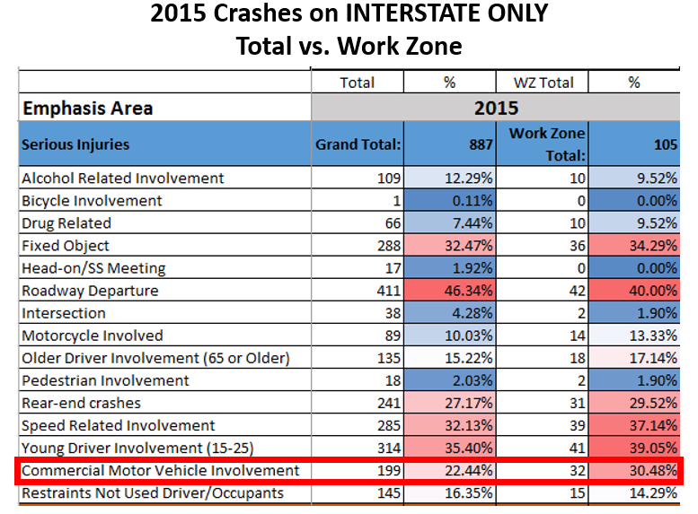
ODOT/OCA Traffic Safety Partnership

Slide 11
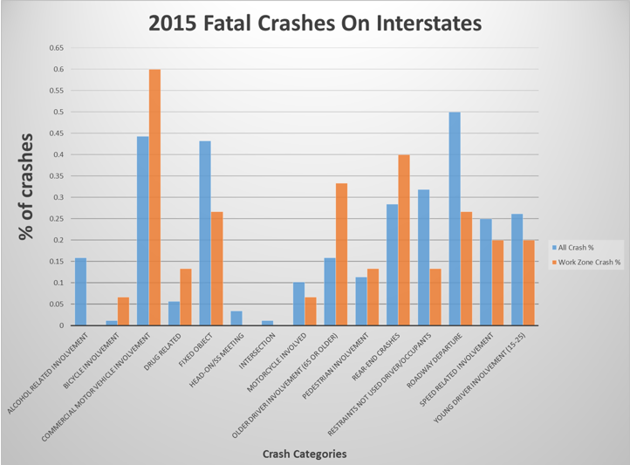
ODOT/OCA Traffic Safety Partnership

Slide 12
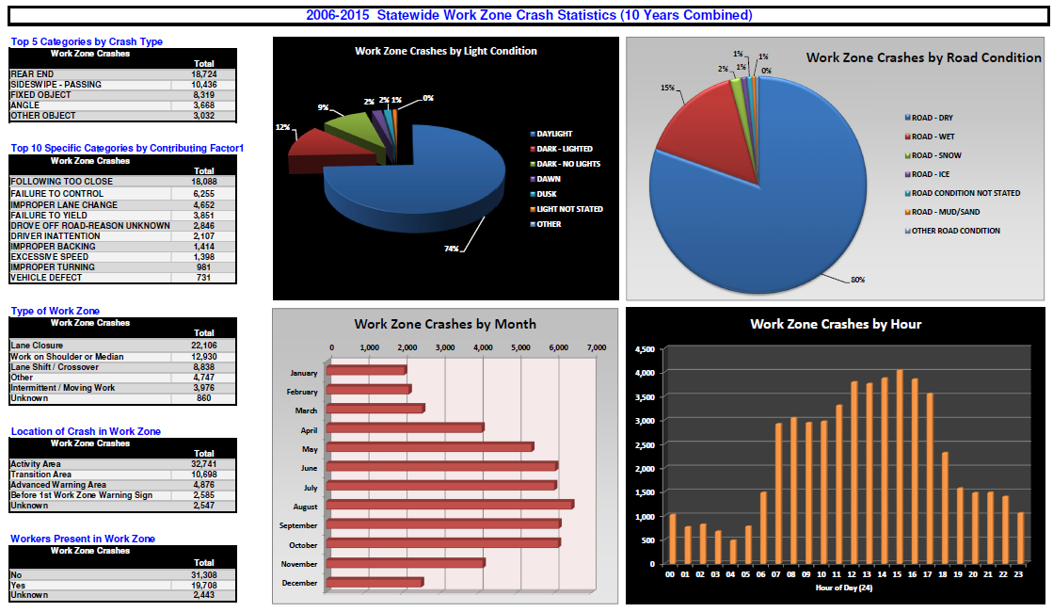
ODOT/OCA Traffic Safety Partnership

Slide 13
ODOT/OCA Traffic Safety Partnership
Work Zone Speeds

Slide 14
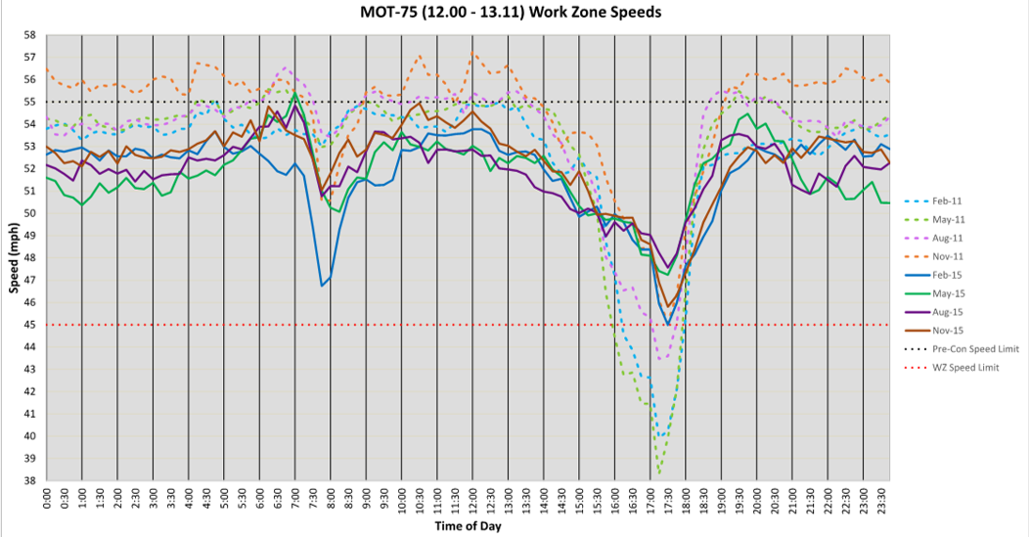
ODOT/OCA Traffic Safety Partnership
New Tool To Monitor Work Zone Speeds – Target Enforcement??

Slide 15
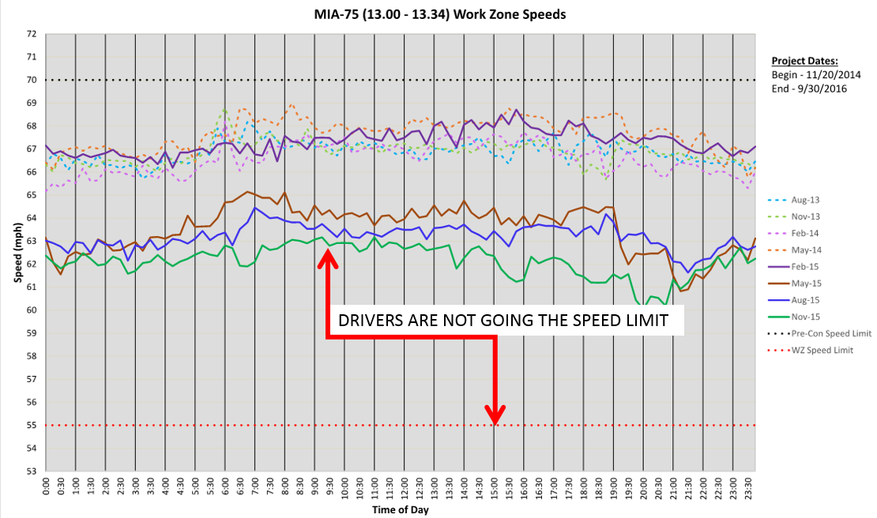
ODOT/OCA Traffic Safety Partnership

Slide 16
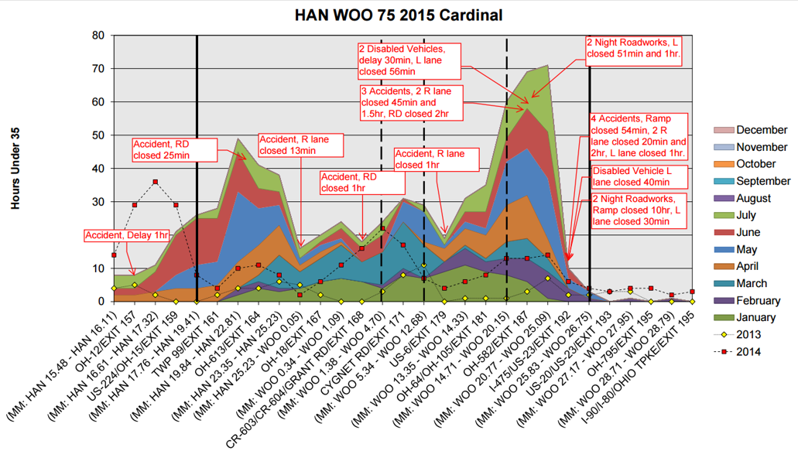
ODOT/OCA Traffic Safety Partnership

Slide 17
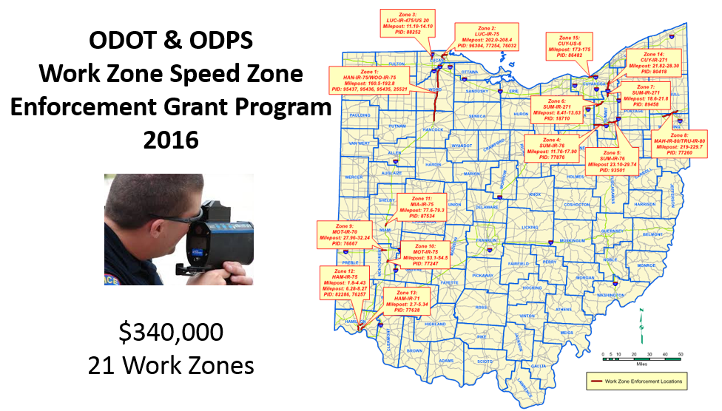
ODOT/OCA Traffic Safety Partnership

Slide 18
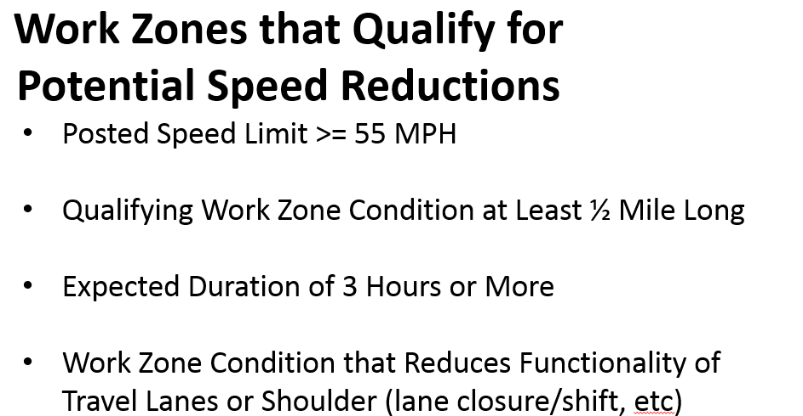
ODOT/OCA Traffic Safety Partnership

Slide 19
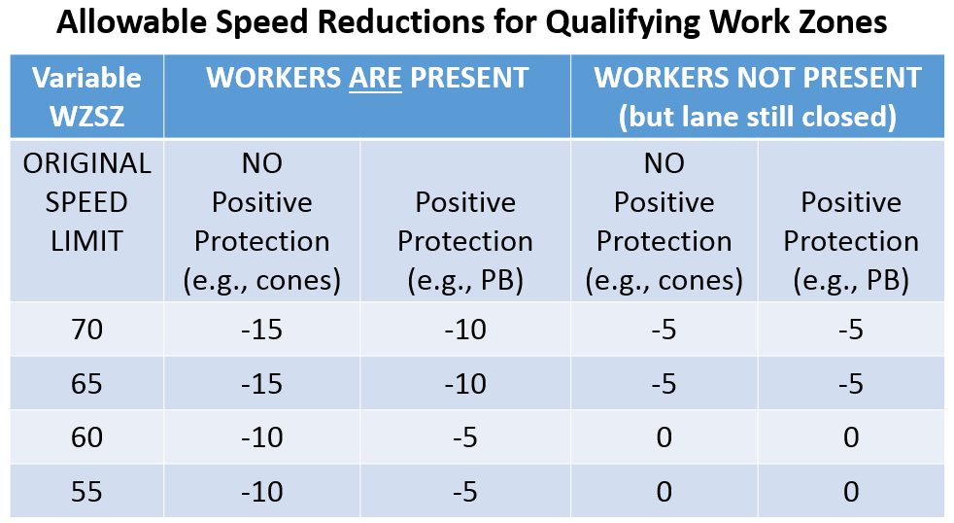
ODOT/OCA Traffic Safety Partnership

Slide 20
ODOT/OCA Traffic Safety Partnership

Slide 21
ODOT/OCA Traffic Safety Partnership
Where Might the Next Safety Idea Come From?
FROM YOU – the Industry
ODOT & the OCA Safety Committee Meets Regularly.
If you have ideas please share them.
Standards;
Policies;
New Products;
Ways to Improve Speed Limit Compliance
Training Needs;
No ideas are bad ideas – please share them with us through the OCA.

